Slide 1
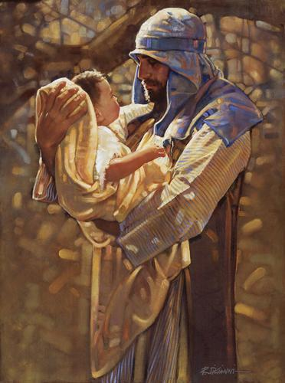
The Dream, The Vision, the calling
“Get down in this trench with Me and be a cornerstone with Me in this new addition!”

Slide 2
The Dream
I want to share with you a very significant spiritual dream that I had the other night. (November 2008) The other night I had a spiritual dream/vision where the Lord came to me and He beckoned me to come with Him saying, "I have some things to show you".

Slide 3
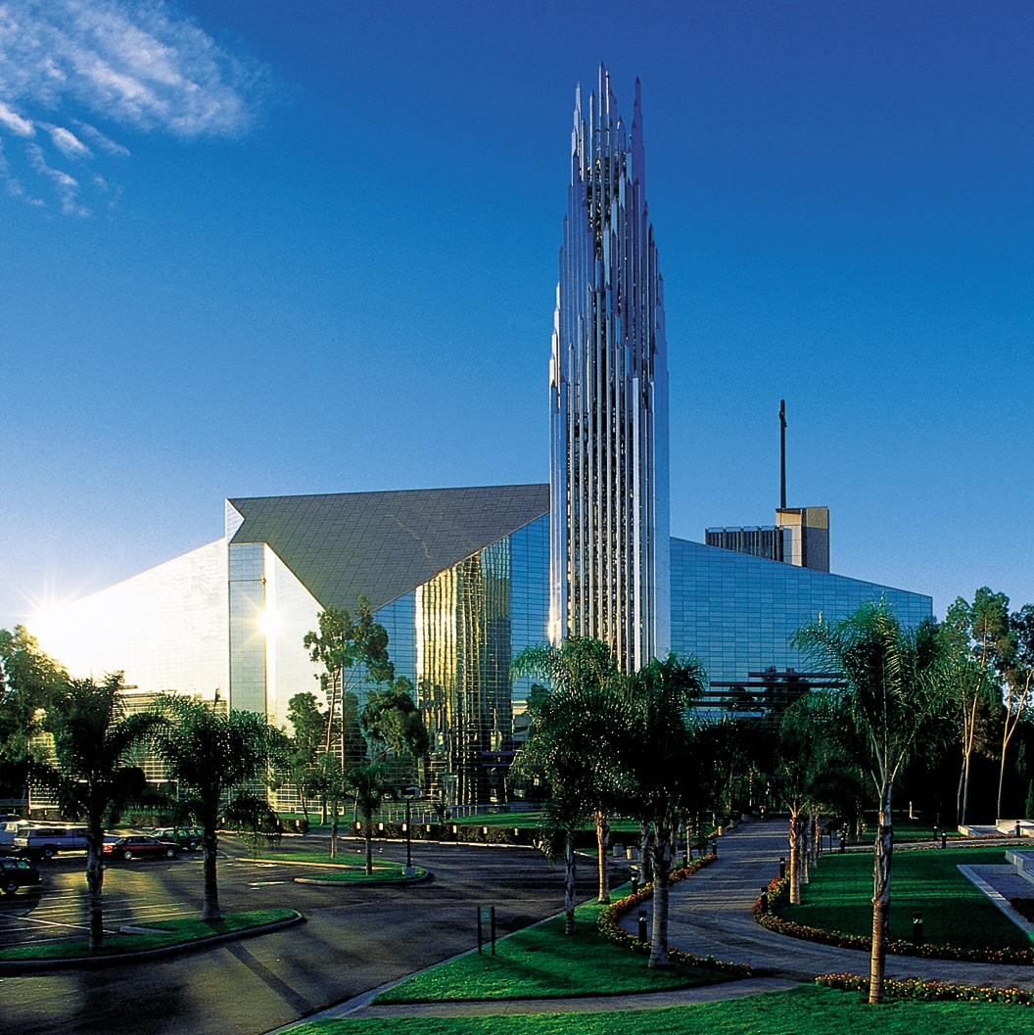
The Dream
We came to a place and He showed me a building that He had built and the building was exceedingly beautiful.
He said, "This is my church. I Am the Architect and the Builder".
I stood there feeling extremely odd because I was at a loss for words. I wanted to respond, but I could only respond by mumbling, "It is exceedingly beautiful!"
Even when I said those words I felt like they were not sufficient and that they were not adequate. I could not find the words to convey the magnitude of what I was seeing…

Slide 4
The Dream
Then He looked me in the eye and spoke directly to me with a piercing question asking, "Tell me where you fit in my church?"
I looked at the building and I looked back at Jesus. I felt the same loss for words that I had felt earlier and no reply that came to mind seemed to be adequate.
At some point I was able to respond saying, "Lord I need for you to tell me where I fit in your church". He responded, "No, you tell me where you fit in my church?"

Slide 5
The Dream
I gazed at the building (church) and then I looked back at Jesus, I considered the perplexing question and then I carefully responded, "Do you want for me to be like a strong column on the front porch, that helps to hold up the roof?" He answered saying simply, "No". I thought for what seemed like a long time and then responded again saying, "Do you want for me to be a brick in the wall protecting what is inside?" He again, with a smile answered saying, "No".
He was smiling, but the overwhelming insinuation was heavy that He wanted an answer from me to His question. I weighed the words in my mind and I thought to myself, "I have been a Christian for over 30 years and I have served as a missionary overseas, so it should be clear where I fit in His church.” Somehow in His presence I could not find an answer that made any sense. It felt like everything that I had presumed over my lifetime of serving the Lord was reduced to one simple yet so very complex question, "Tell me where you fit in my church".
"Tell me where you fit in my church".

Slide 6

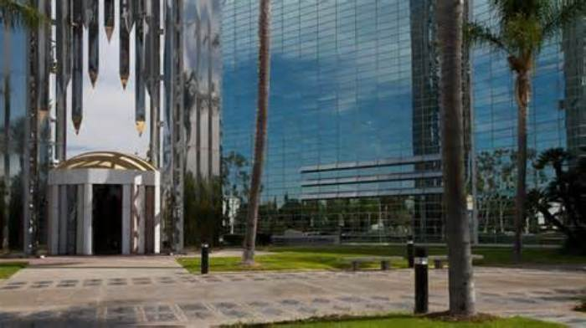
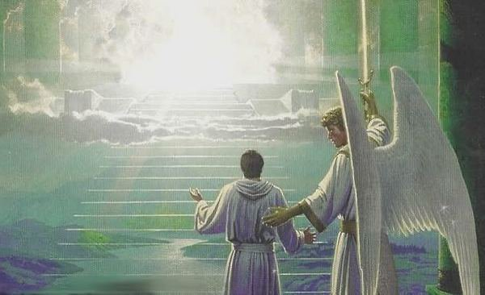
The Dream
I use to work in a public agency where I was audited every year on my purchasing and inventory control role. I need to say that in some sense this question from Jesus was similar to being audited wherein there was an expectation of a right answer, yet no reasonable answer seemed sufficient or made any sense.
So as I pondered this, I looked at the church and I said, "Do you want for me to be like the front door inviting others in?" He said, "No, but let's go inside".
I felt so lost for an answer...

Slide 7

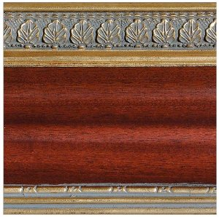
The Dream
As we passed through the doors and went inside Jesus said again to me, "Tell me, where you fit in my church?"
I looked around trying to come up with something to say and I honestly said, "Do you want for me to be like the crown molding, making things pleasant in your church?“
He responded by saying, "No...let's go back outside. I have something to show you that you have not yet seen.“
I felt incapable of a correct answer to His piecing question…

Slide 8
The Dream
As we went outside He said, "This is my building, my church, I am the Architect and the Builder. I built it, but I have some workers who are building additions to it around the back."

Slide 9
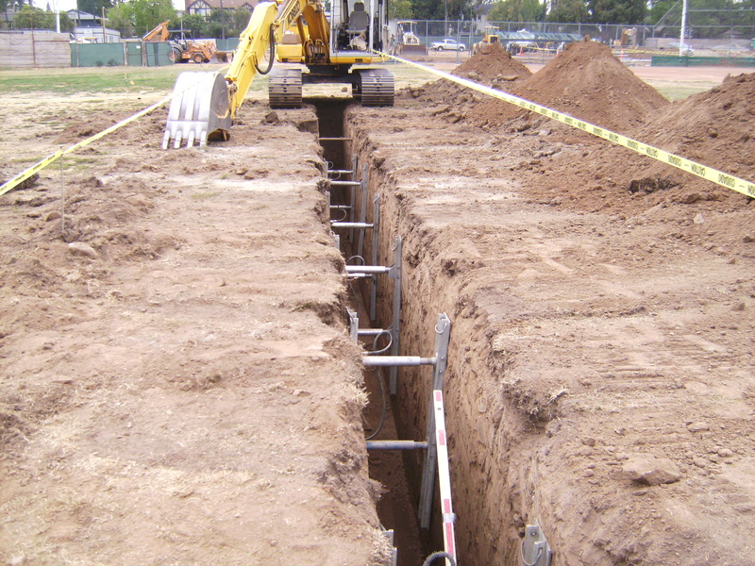
The Dream
As we went around towards the back He asked, "What do you see?"
I responded saying, "Someone has been working here and they have marked off the area. They have been digging trenches for a new addition."
He said, "That's right!...Now tell me where do you fit in here?"
I felt pierced inside because I had no answer that made any sense. This time I spoke from my heart saying, "Lord please tell me where do I fit in your church?"

Slide 10
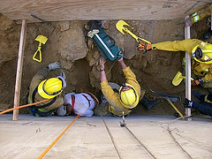
The Dream
He answered saying, "Tell me what you see." I responded saying, "Inside of the trench, I see a stone."
Then He replied, "You have always been one of my cornerstones. Get down in this trench with Me and be a cornerstone with Me in this new addition."
It was revelation, but I recall saying in my own mind, "A cornerstone? A cornerstone is not what I would have thought! A cornerstone is down under the earth and once the building is built, it is not hardly seen or heard of again."

Slide 11
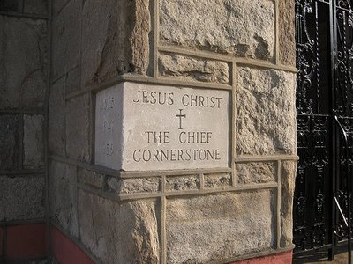
The Dream
Then Lord responded having known my thoughts and said, "You are not telling me anything that I don't know or haven't experienced, I am the Chief Cornerstone that the builders rejected. If the cornerstones fail, so does the building. If the cornerstones are not tested and proven then they cannot withstand the pressures or bear the weight and the building will fall. You have been tested and proven, although others have stolen my glory, you have not. Come down here with me in this trench and be a cornerstone with me for this new addition".

Slide 12

The Calling
The dream/vision ended there in November of 2008 with a clear understanding that the Lord would be doing something new and that He wanted for me to be a "cornerstone" in that particular addition.
I sensed clearly that the new addition was a “Latin American Addition.”
Cornerstones are not seen. Cornerstones are down in the trenches, buried under the dirt. Cornerstones are rarely thought of. Cornerstones are by the Lord's own words essential, vital and have to be well tested and proven in order to bear the load.
The truth of the matter is that it is a humble position, but it is a position that our own Lord fulfilled as He was rejected as the Chief Cornerstone.
The Lord made clear that He has other cornerstones who are serving in each corner of this “Latin American Addition” and even in other additions. It was upon these cornerstones that all of the building materials would be fitted together and fastened to form the new additions.

Slide 13
The Vision
I don't presume to understand the "full" ramifications of such a dream or vision. I do understand that the Lord has called me and my family to serve as “cornerstones” for a new “Latin American Addition,” that the Lord himself is adding to His church.
Is it a new church? No there is only one body. Is it a new denomination? Surely not-We have too much division.
The Lord seems to be adding “A Latin American Addition” to His church and her means to reach out to both the believer and the unbeliever?
I think this is the correct thinking in this regard. The Lord will be doing a new thing in His church.

Slide 14
The Calling
I want to share with you that since the year 2008 I have abandoned my own pursuit of life in order to answer this calling from the Lord. I have walked away from job offers and worldly security to become one of the Lord's "cornerstones" working down in the trenches.
Why would I do that? Because the Lord said, "Get down here with Me in the trench and be a cornerstone with Me for this new addition." It is that simple and that complex.
Amen – November 2008
Habakkuk 2:3 For the vision is yet for an appointed time and it hastens to the end [fulfillment]; it will not deceive or disappoint. Though it tarry, wait [earnestly] for it, because it will surely come; it will not be behindhand on its appointed day.
The testing has been severe from 2008 to 2016 but the Holy Spirit says, “You now have an anointing that you had not before!” (2013)

